Slide 1

DSI Tableau

Slide 2
Overview
Why is data important
What is Tableau
What files can we use?
What are some big concepts?
Exercises
Small data project
End Reflection
More resources

Slide 3
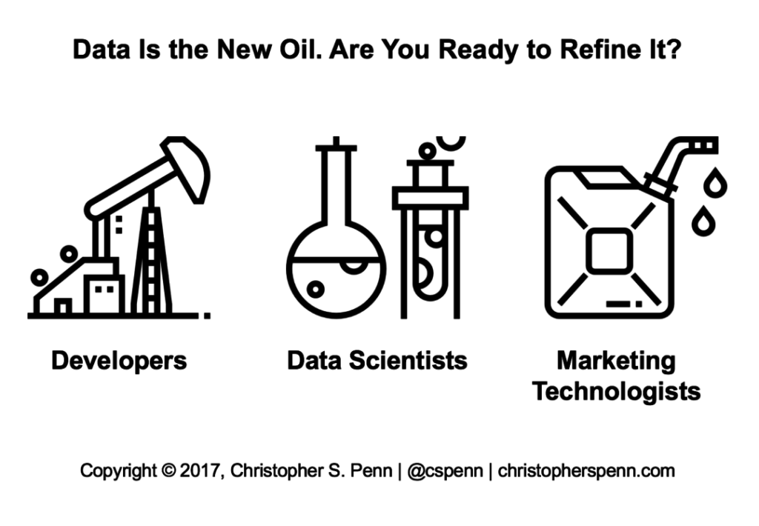
Data is the new oil
Software to Extract data from users.
Processing and refinement .
Sale of that clean useful data.

Slide 4
Getting Tableau Setup
Make an account and get 14-day free trial.
Sign up for a school account(takes a day or two to approve)
UF APPS (citric receiver)
Notes:
Consider talking about:
Data requirements
Data collection
Data processing
Data cleaning
Exploratory data analysis
Modeling and algorithms
Data product
Communication

Slide 5
Get the Code
Go to https://github.com/dsiufl/Tableau_Workshop
- Download and unzip file

Slide 6
10,000 Foot View
Blue
Continues
Dimension
Categories
Green
Measurements
Instances

Slide 7
1,000 Foot View
File types
.twb – Workbook
.tds – Data source
.tbm –Bookmark
.xlsx – Excel file
.csv – Comma Separated Value
Data Source, Sheets, Dashboards, and Stories

Slide 8
100 Foot View Let's Dive In !
Data source
Data interpreter
Pills
Show me
Options
Notes:
Consider talking about:
Confusing fact and opinion
Cognitive biases
Innumeracy

Slide 9
Data Project
Import
Hate Crime Data
Make
Make Sheets
Merge
Merge to make a presentation
Export
Export as PDF
Notes:
Consider talking about:
Initial data analysis
Main data analysis

Slide 10
Extra Resources
Tableau - https://www.tableau.com/support
Linked in Learning - https://www.linkedin.com/learning/
Practical Tableau - https://www.amazon.com/Practical-Tableau-Tutorials-Strategies-Master/dp/1491977310
Follow us !
Data Science - https://www.facebook.com/groups/DataSciUF/

